Slide 1


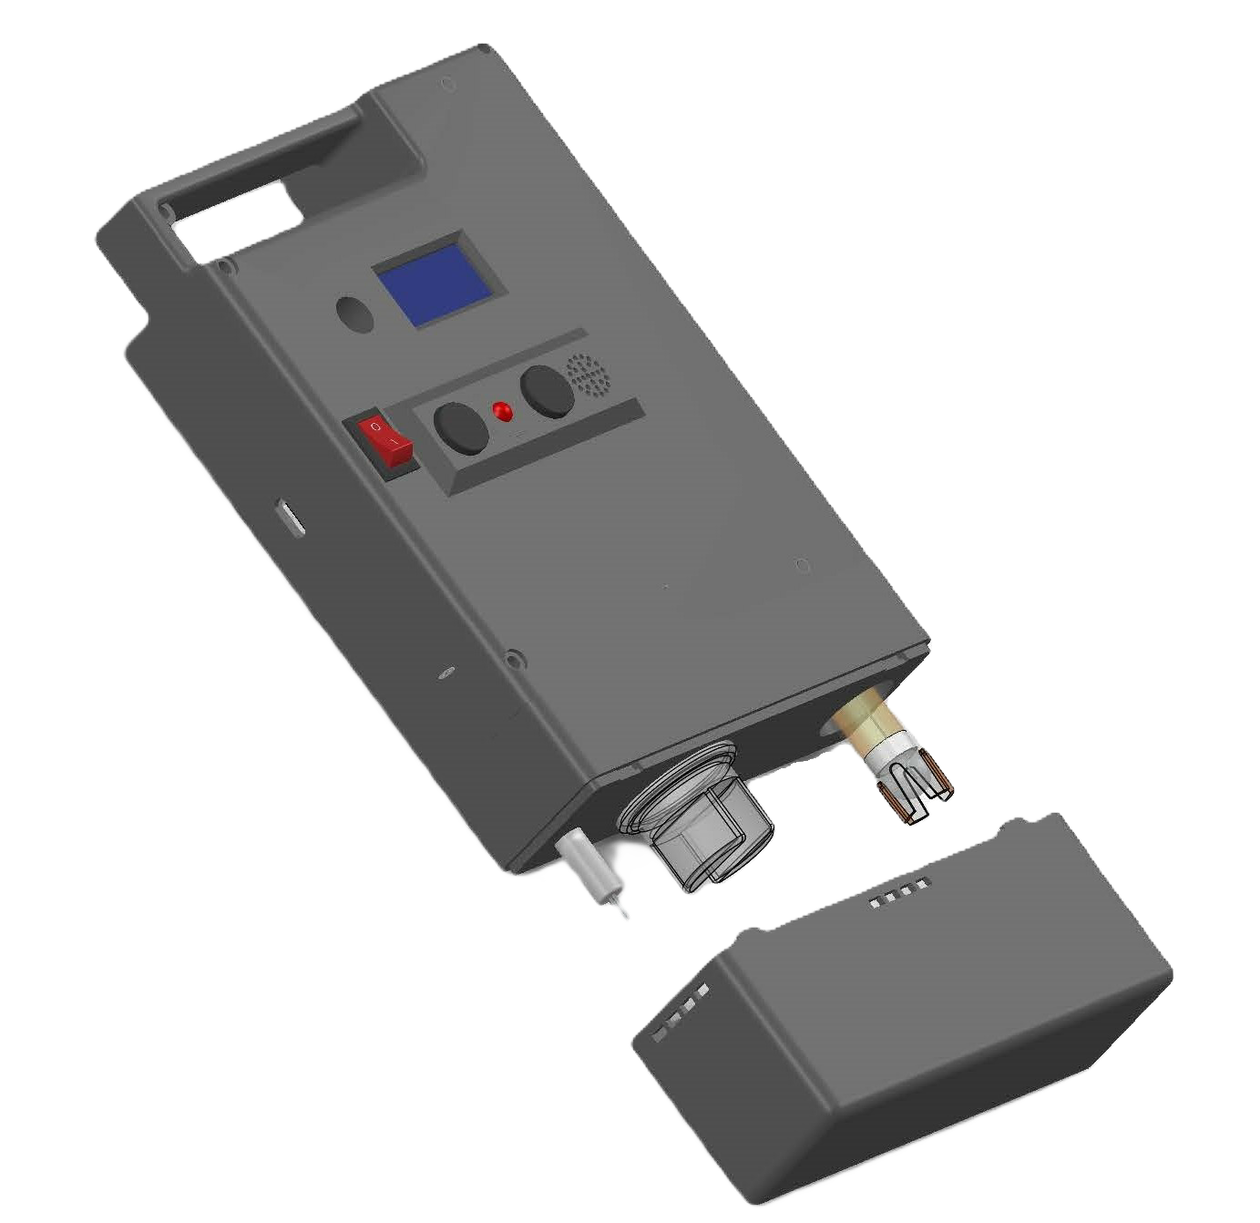
Trail Guard
By Electro squad
Final
Report
220054N Balasooriya BAPI
220112R Dewasumithra MPO
220128V Dineshara MC
220143L Diunugala CH
www.traiguard.com

Slide 2
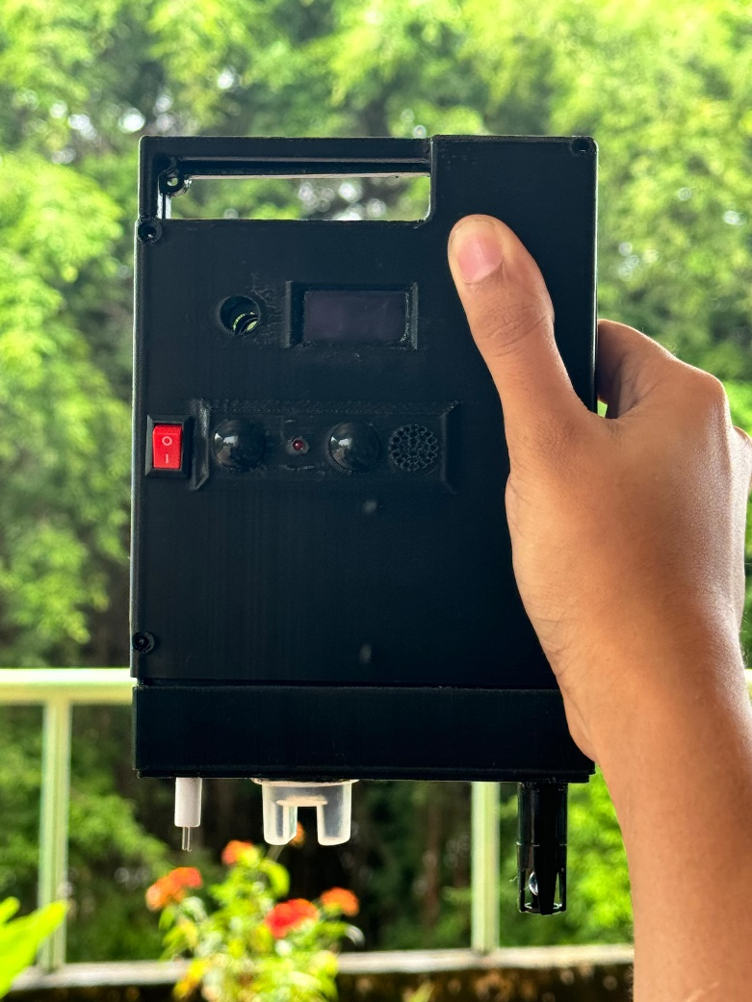

ABOUT
Trail Guard
Sensors and Parameters
Sensor | Parameter
TS-300B | Turbidity
PH4502C | PH
DHT11 | Temperature and Humidity
GP2Y1010AU0F | Dust Density
MQ2 | CO2/CO/LPG
Gravity TDS | TDS
Trail Guard is developing a portable device that monitors various environmental parameters, including air and water quality, using a wide range of sensors. This comprehensive monitoring tool is designed to be valuable for both travelers and residents who are concerned about their environmental conditions..

Slide 3
Key Features
1
Comprehensive Monitoring
4
Rechargeable Battery
Provides long-lasting power for extended use.
Tracks Dust, Temperature, humidity, gas levels, turbidity, TDS and PH.
2
Portable
4
Critical condition alarm
Light weight and easy to carry for outdoor adventures
Alerts with sound and light when dangerous conditions are detected
3
User-Friendly
Clear display with intuitive buttons and alarms for hazards.

Slide 4
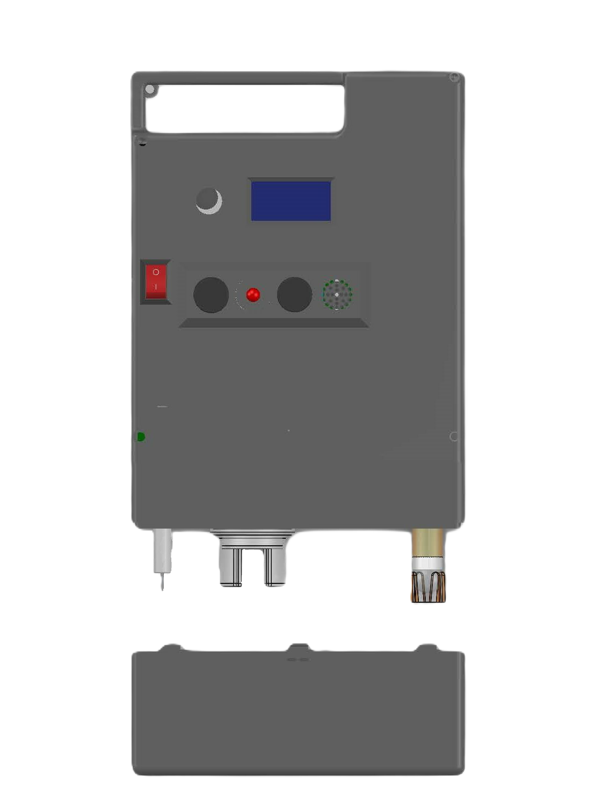
Technical Specification
Measurement Range
Power Supply
Rechargeable 3200mah Li-ion battery lasting about 6 hours
Dust Sensor: PM2.5 (0-500 μg/m³ )
MQ2 Gas Sensor: CO₂, CO, Methane, Butane, LPG(0-1000ppm)
Temperature: -10°C to 50°C
Humidity: 10-90% RH
Turbidity: 0-3000 NTU
TDS: 0-500 ppm
pH: 0-14
Display: OLED display
Button: Two control buttons for navigation and settings
Operating Temperature
-10°C to 50°C

Slide 5
Guidelines followed for Water and Air Quality
NATIONAL ENVIRONMENTAL ACT NO. 47 OF 1980
Government of Sri Lanka
Parameter | Units | Drinking Water (Category A) | Recreational Water (Category B)
pH | - | 6.0 - 8.5 | 6.0 - 9.0
Total Dissolved Solids | NTU Max | 5 | -
Turbidity | ppm Max | 500 | -
Pollutant | Units | Max Permissible level
Particular matter | µg/m³ | 100
Carbon Monoxide(CO) | ppm | 50

Slide 6
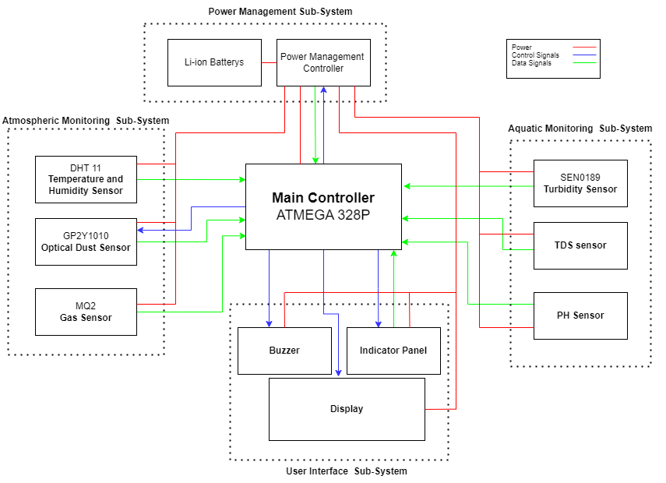
Block Diagram

Slide 7
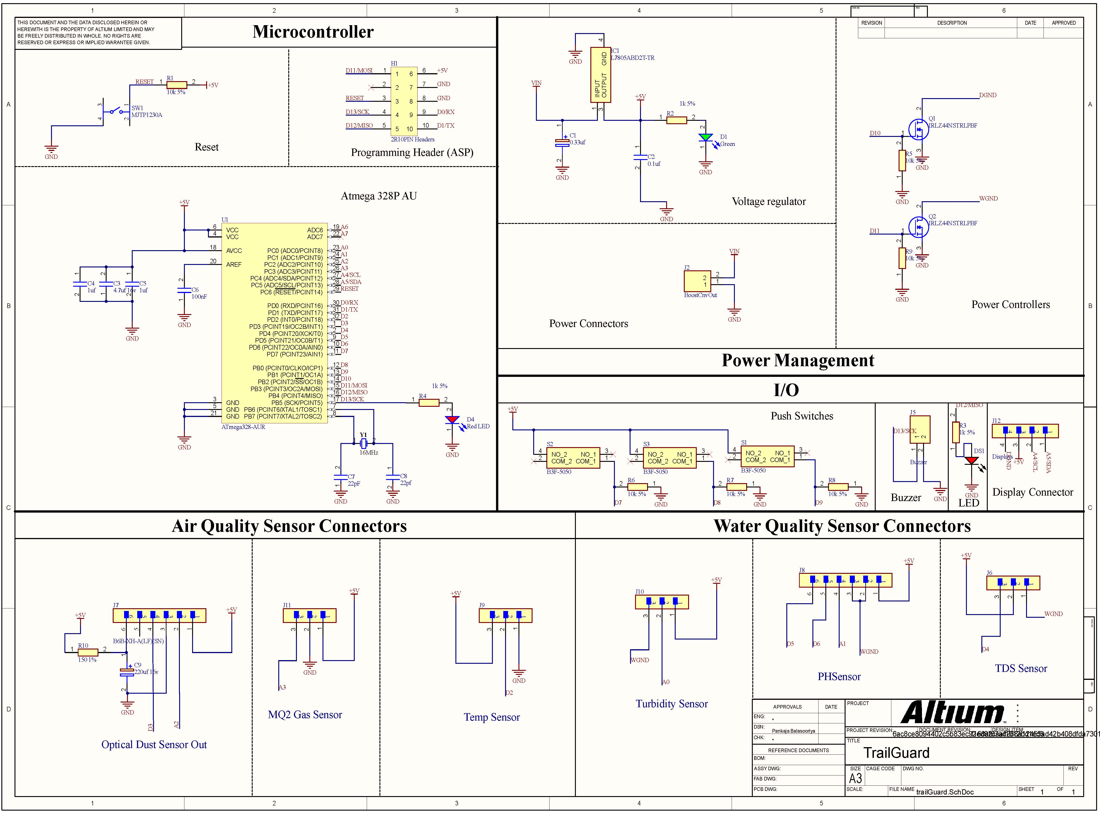
PCB schematic

Slide 8
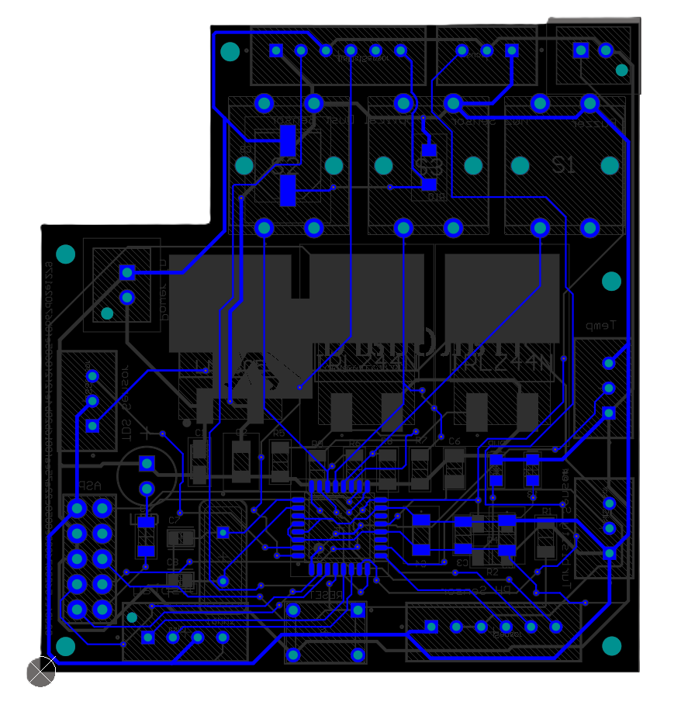
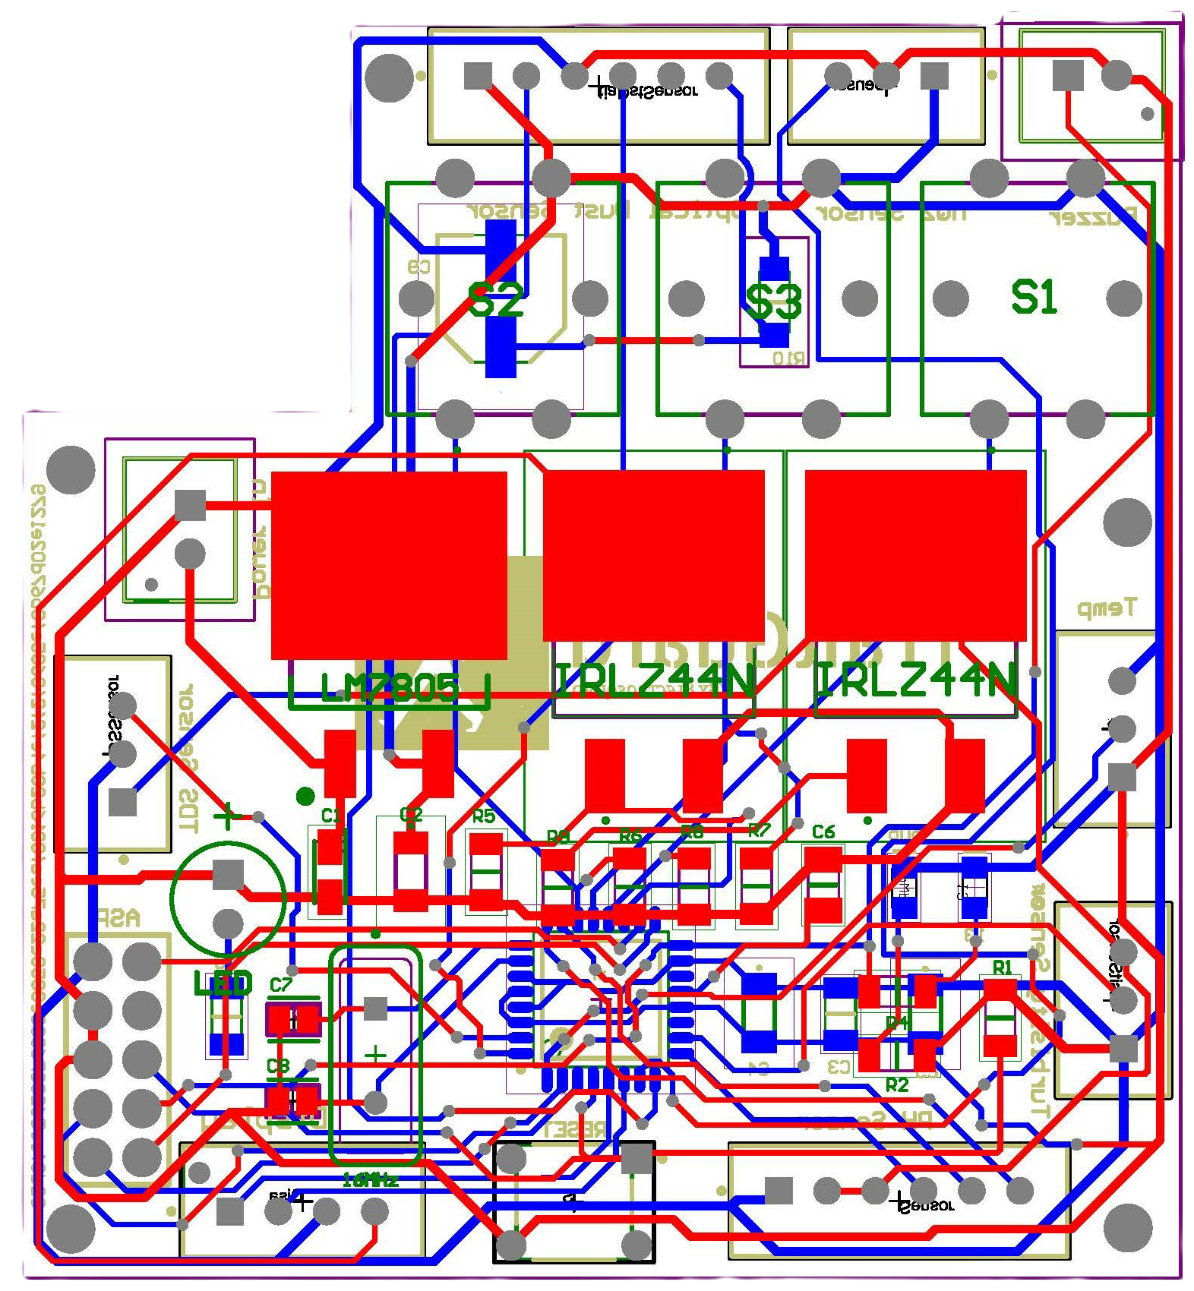
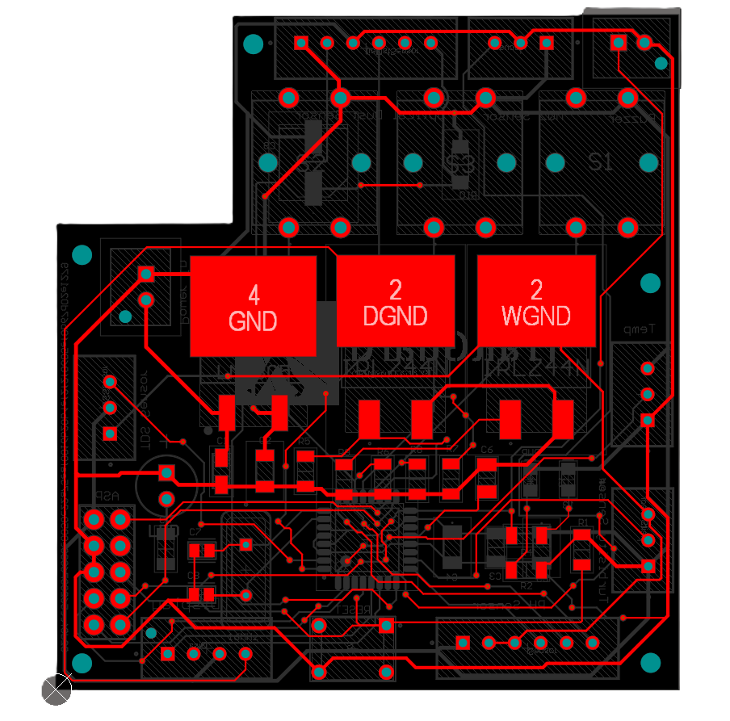
PCB Design

Slide 9
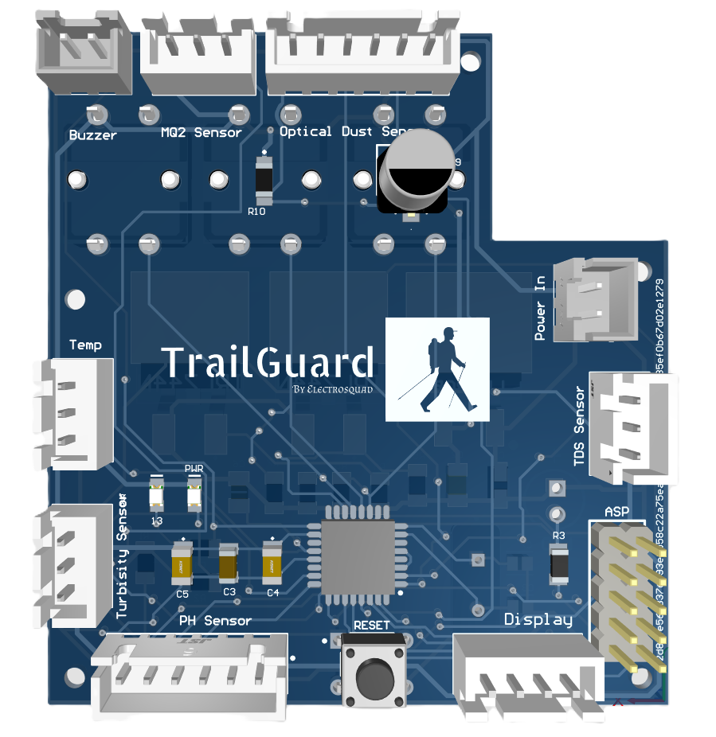
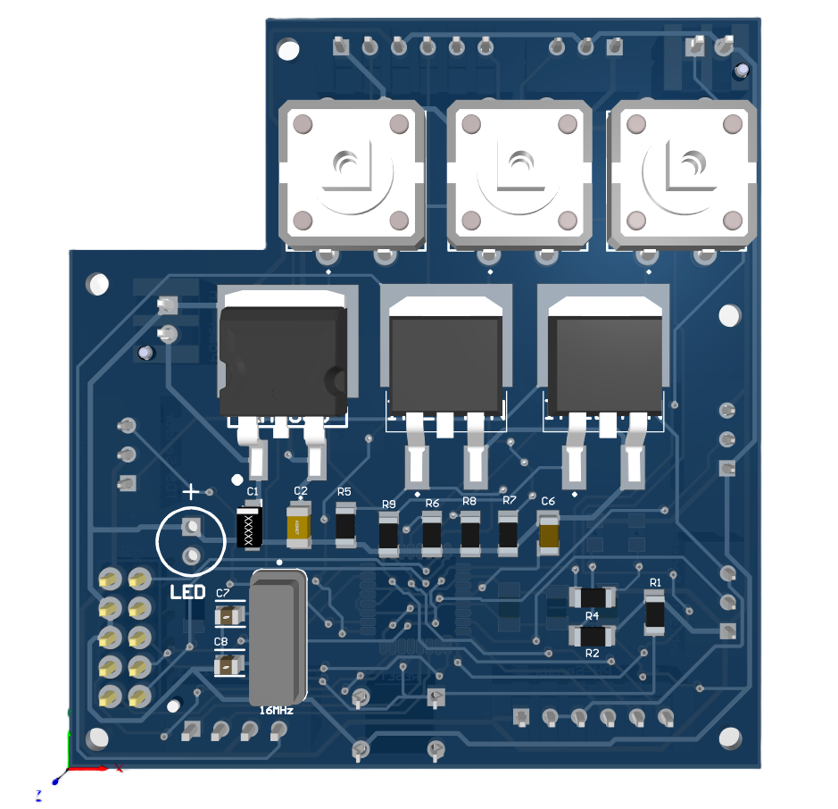
PCB Design

Slide 10
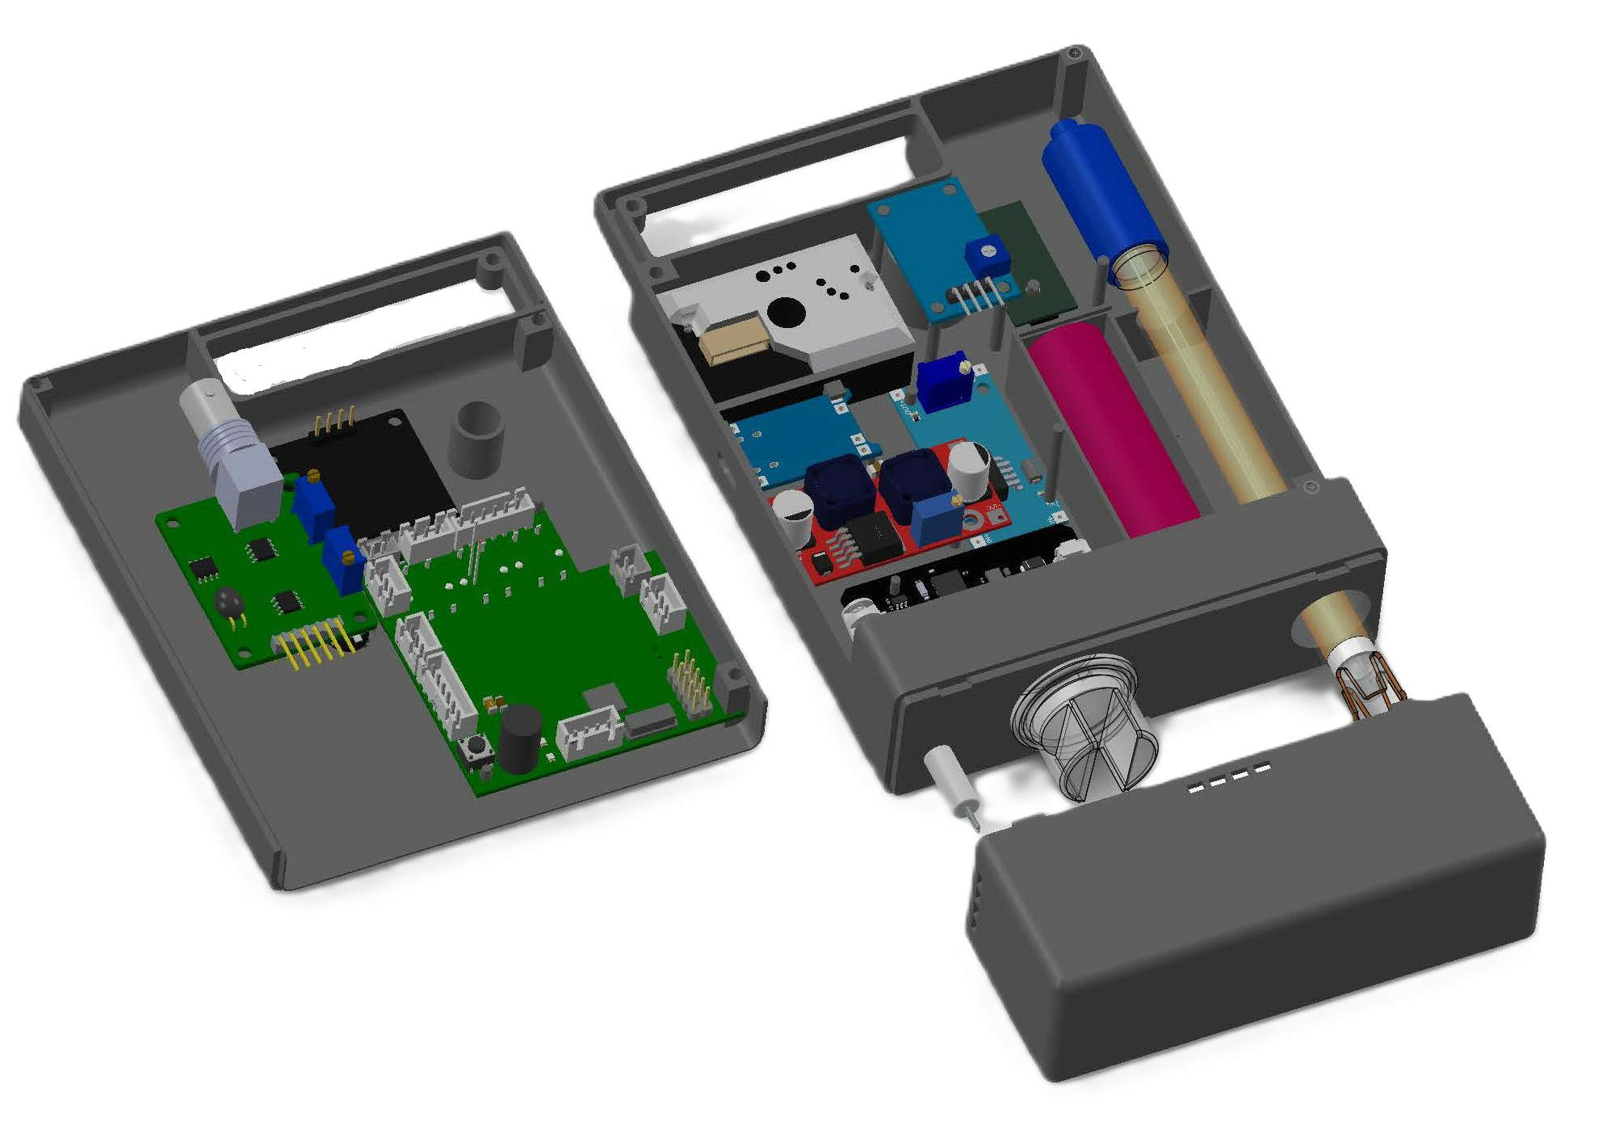
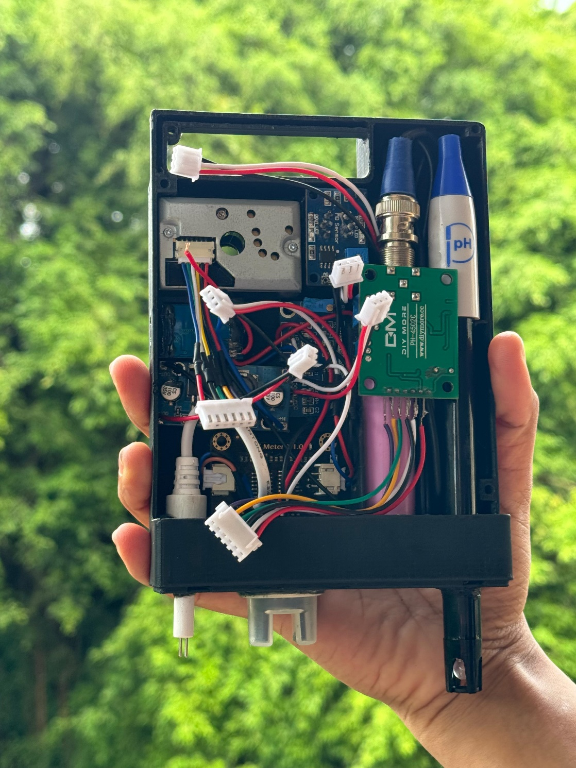
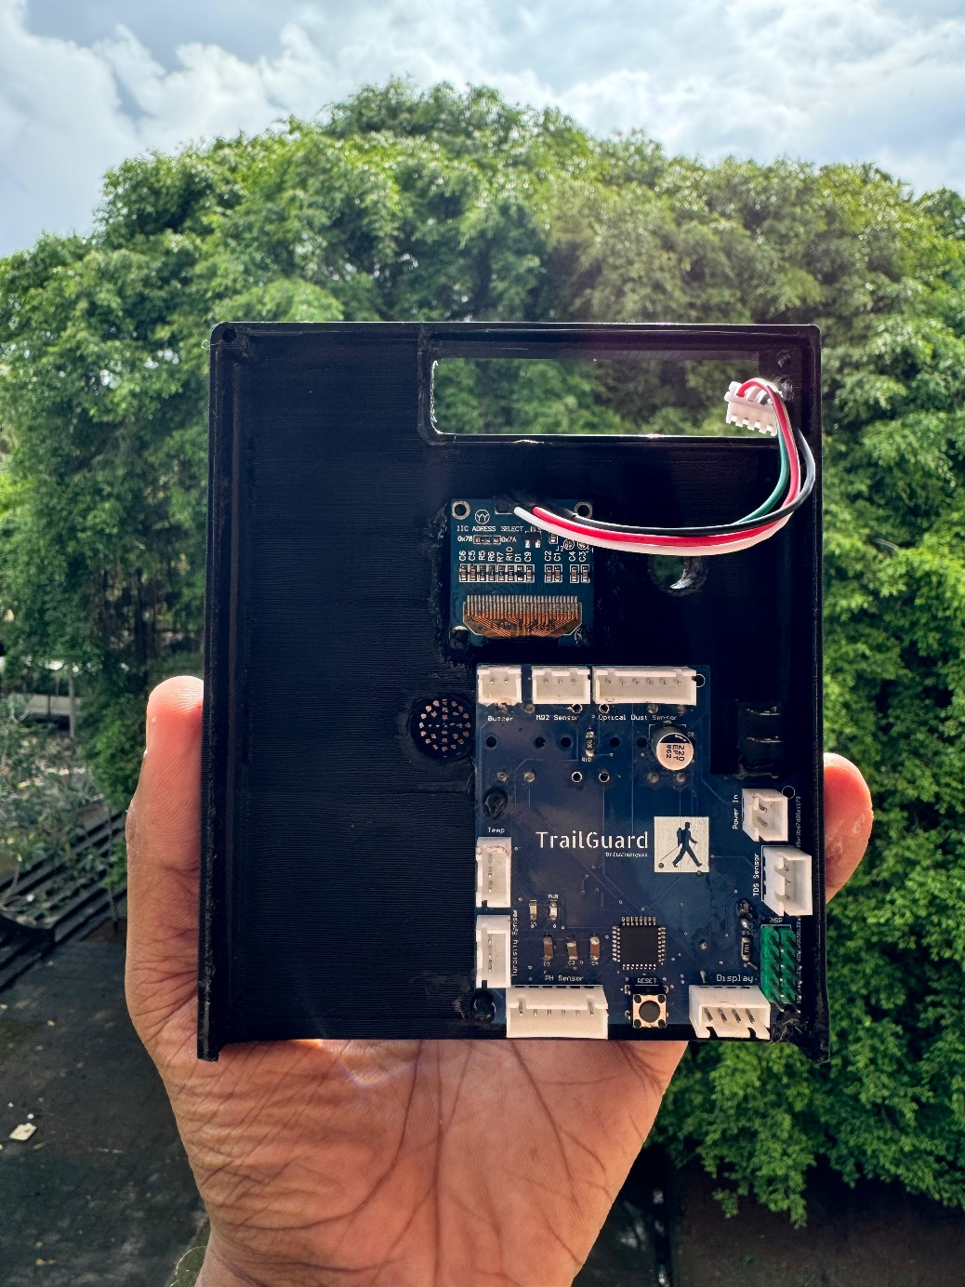
Internal View

Slide 11

TrailGuard

Slide 12
Task Allocation
Name | Index Number | Task
Balasooriya B A P I | 220054N | PCB Design and Circuit Design
Dewasumithra M P O | 220112R | Enclosure Design and Circuit Designing
Dineshara M C | 220128V | Programming and Enclosure Design
Diunugala C H | 220143L | Programming and PCB Design

Slide 13









